Slide 1
MONITORING & ALERTING WITH AMAZON CLOUDWATCH

Slide 2
Project Overview
This project focused on implementing a real-time monitoring and alerting solution using AWS native services. The goal was to proactively monitor system performance and receive automated notifications whenever predefined thresholds were exceeded, ensuring system reliability and operational awareness.

Slide 3
Objectives
Monitor the performance of Amazon EC2 instances
Configure alarms based on key performance metrics
Set up automated notifications for critical events

Slide 4
AWS Services Used
Amazon CloudWatch – for metrics collection, monitoring, and alarms
Amazon SNS – for sending alert notifications via email

Slide 5
Key Responsibilities
Enabled CloudWatch monitoring on EC2 instances
Tracked CPU utilization metrics in real time
Created CloudWatch alarms with defined CPU usage thresholds
Integrated alarms with Amazon SNS to send email notifications when thresholds were breached

Slide 6
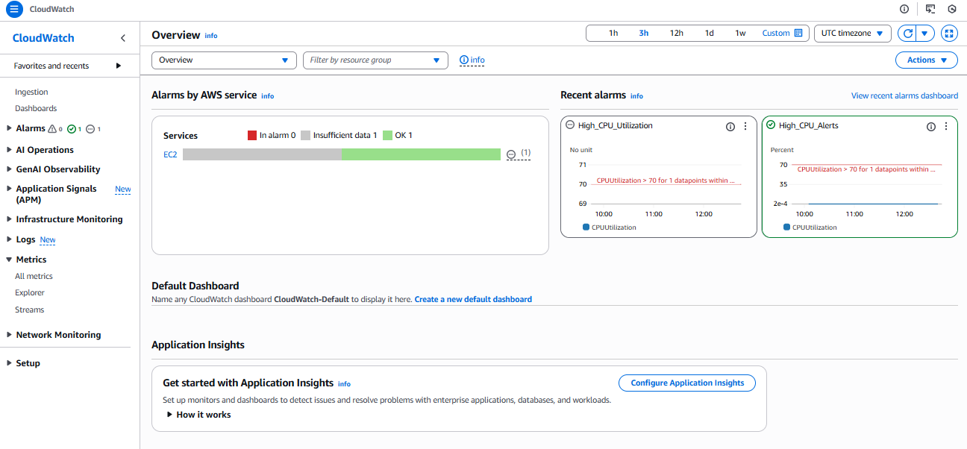
Enabled CloudWatch monitoring on EC2 instances

Slide 7
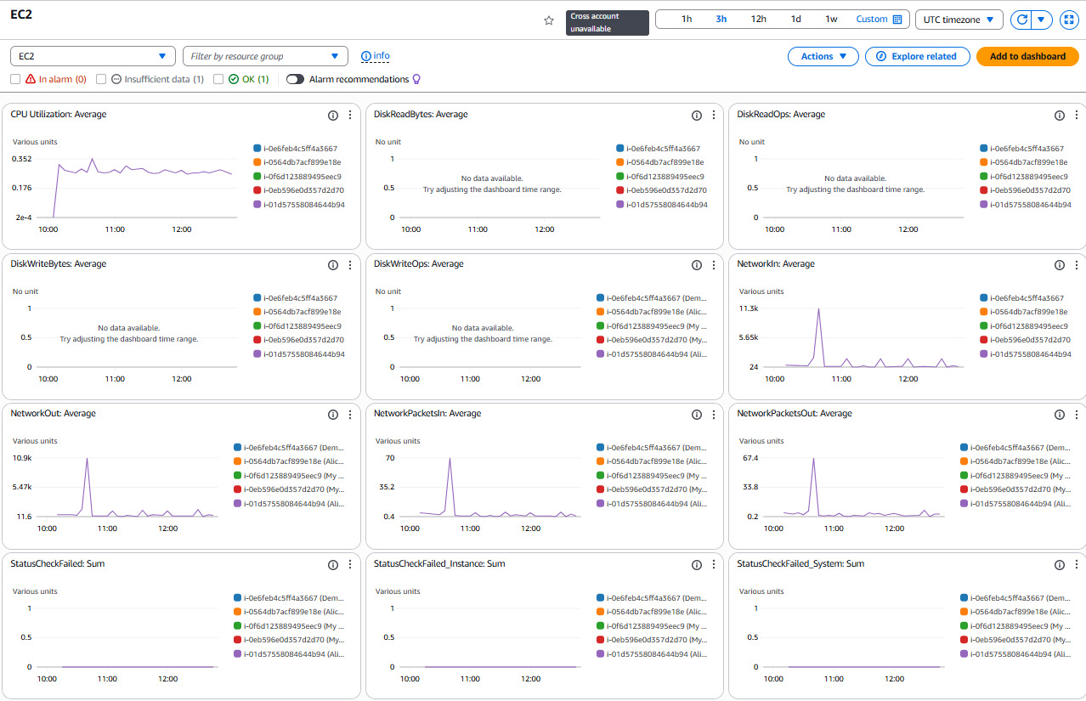
Tracked CPU utilization metrics in real time

Slide 8
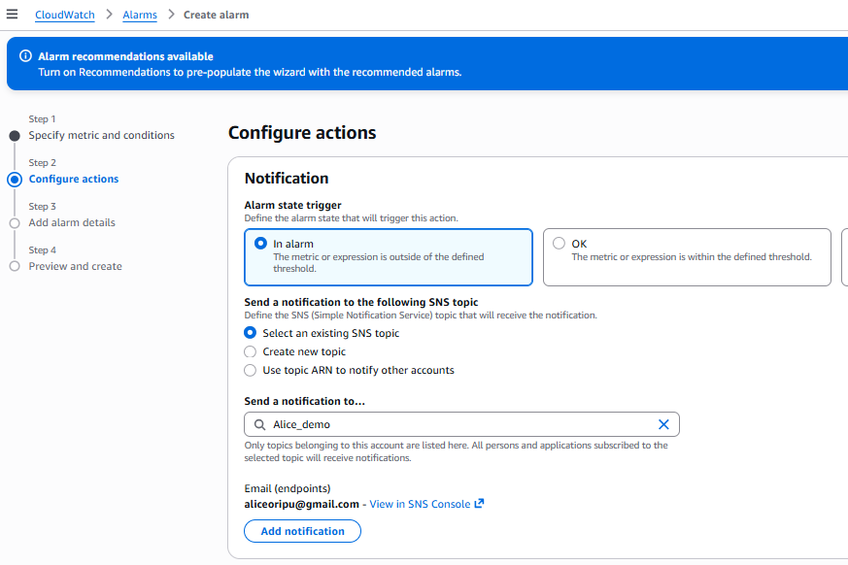
Created CloudWatch alarms with defined CPU usage thresholds

Slide 9
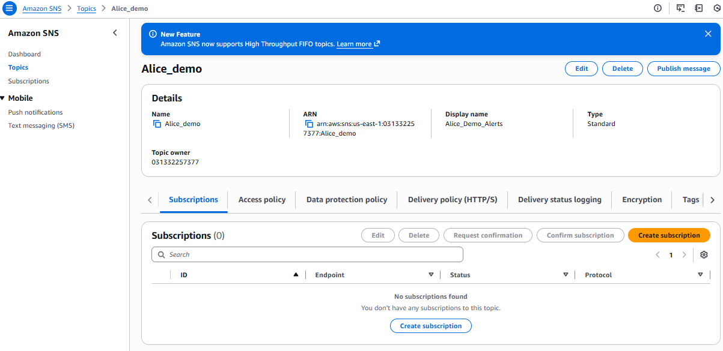
Integrated alarms with Amazon SNS to send email notifications when thresholds were breached

Slide 10
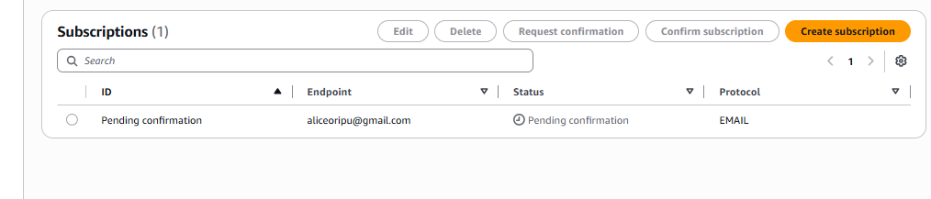
Cont…

Slide 11
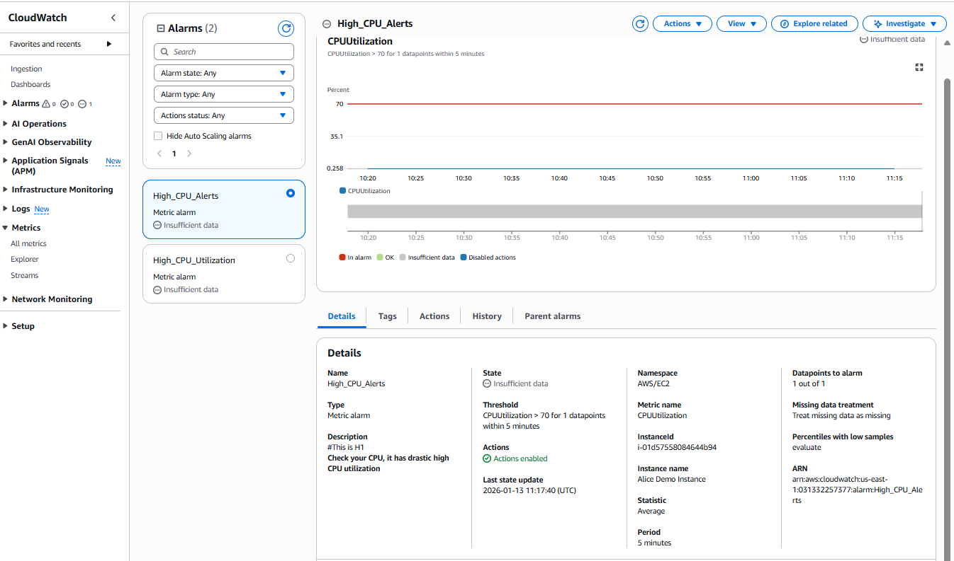
Cont…

Slide 12
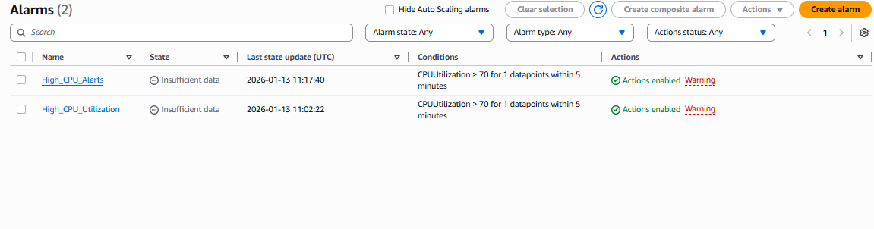
Cont…

Slide 13
Security Considerations
Alert notifications were restricted to authorized email recipients only
AWS IAM best practices were followed to ensure secure access to monitoring and notification services

Slide 14
Results & Outcomes
Successfully implemented automated monitoring and alerting
Achieved real-time visibility into EC2 performance
Enabled proactive response to potential performance issues before system failure

Slide 15
Skills Gained
Cloud infrastructure monitoring
Performance analysis and metrics interpretation
Alerting and incident awareness automation
Practical experience with AWS observability tools

Slide 16
Conclusion
This project demonstrated the ability to design and implement a reliable monitoring and alerting system using AWS services. By leveraging Amazon CloudWatch and Amazon SNS, I gained hands-on experience in proactive system monitoring—an essential skill for cloud, DevOps, and site reliability engineering roles.

